Slide 1

Optimized Tactical Routing for Unmanned Ground Vehicles
CDT Jacob Hyatt
Advisor: LTC Grymes, COL James, Dr. Jane

Slide 2
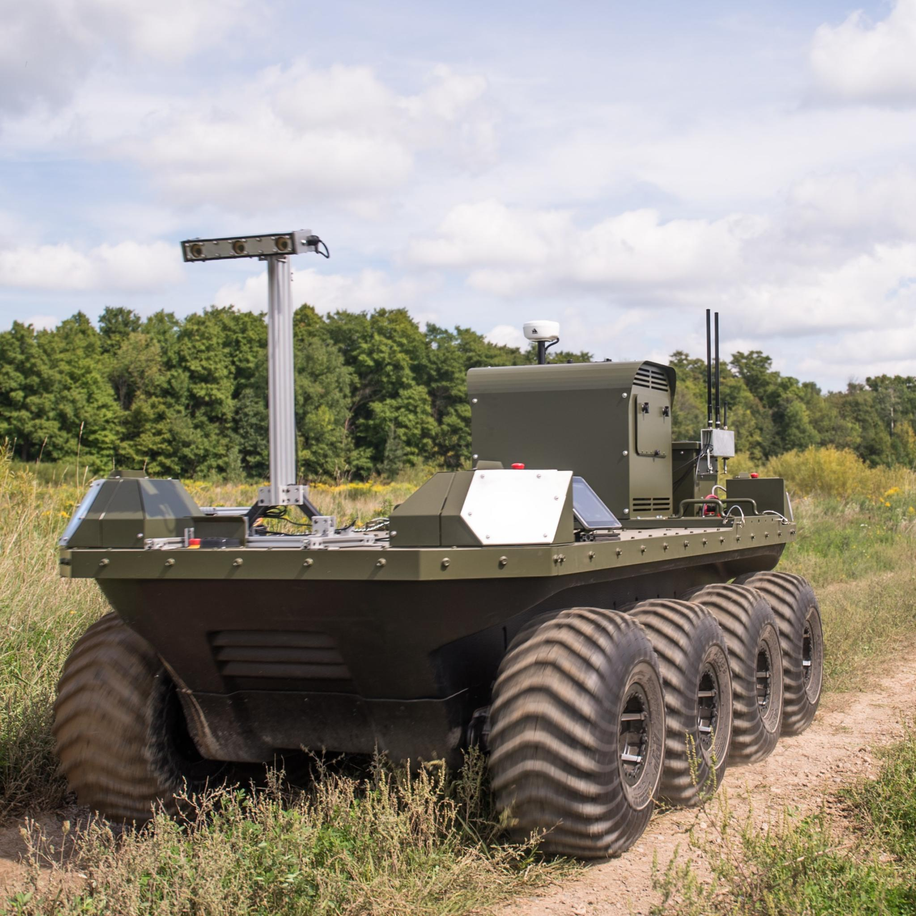
Scope
What is the optimal path for an unmanned ground vehicle in a contested environment?

Slide 3
Model
S
1
2
Top-Down View
E
3
4
F
Charging
Not Charging
Probability of Detection
Notes:
Taking the framework from the last problem to apply it to UGV
UGV have a set battery charge
UGV has a generator that offsets power use, but increase prob of detection due to noise created
UGV can charge using regenerative braking or a generator

Slide 4
Model Inputs
Inflow Arcs: All arcs that flow into a node
Outflow Arcs: All arcs that flow out of a node
1
2
3
1
2
3
4
5
6
4
5
6
7
8
9
7
8
9

Slide 5
Arc Weights
Arc Weights: vector that encapsulates all arc information
1
From
To
Arc i
Detection Level
Energy Level
2

Slide 6
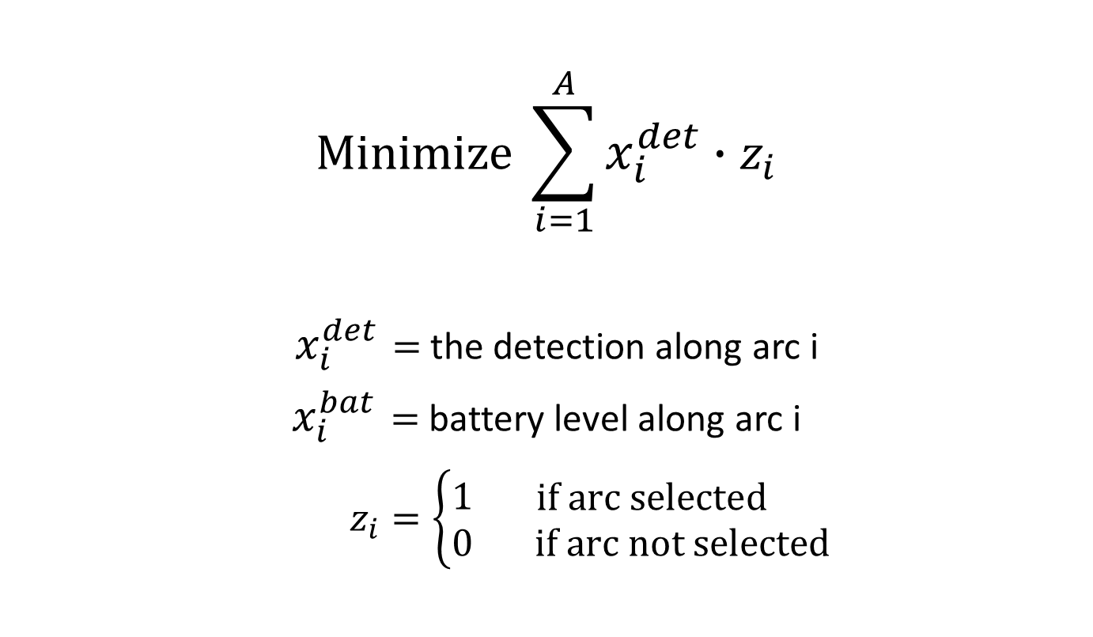
Objective Equation
$$\text{Minimize} \sum_{i=1}^{A}{x_{i}^{det}∙z_{i}}$$
$x_{i}^{det}=$ the detection along arc i
$x_{i}^{bat}=$battery level along arc i
$z_{i}=\left\{\begin{aligned}1 \\ 0\end{aligned}\begin{matrix}\text{if} \text{arc} \text{selected} \\ \text{if} \text{arc} \text{not} \text{selected}\end{matrix}\right.$

Slide 7
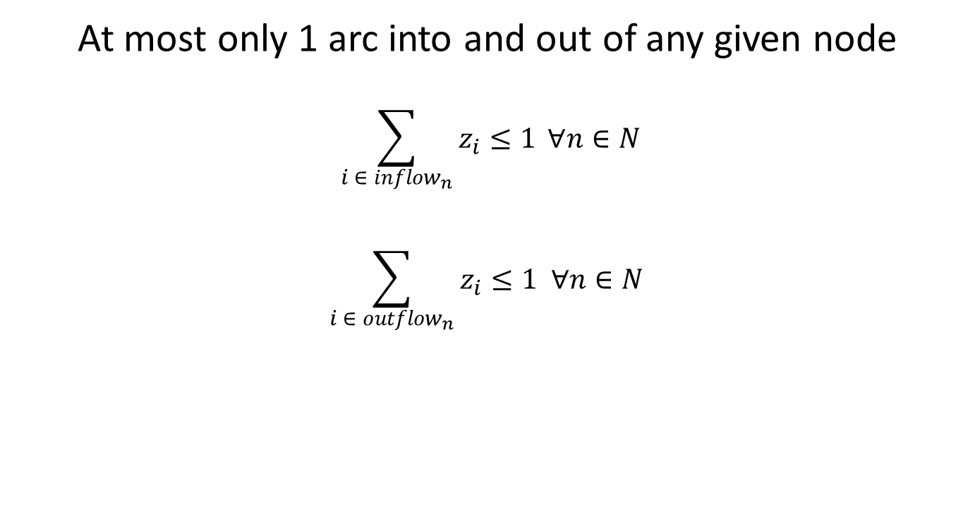
Flow Constraints
At most only 1 arc into and out of any given node
$$\sum_{i ∈ inflow_{n}}{z_{i}≤1} ∀n∈N$$
$$\sum_{i ∈ outflow_{n}}{z_{i}≤1 ∀n∈N }$$
S
1
2
S
1
2
3
4
F
3
4
F

Slide 8
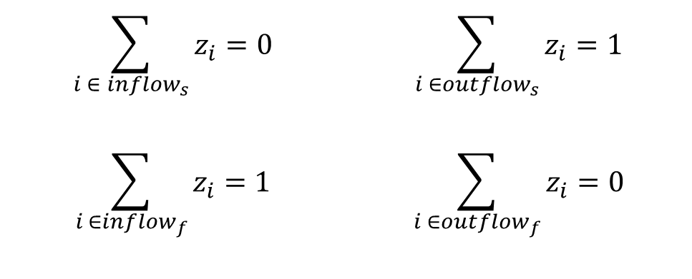
Special Flow Constraints
Start and Final considerations
$$\sum_{i ∈ {inflow}_{s}}{z_{i}}=0$$ | $$\sum_{i ∈{outflow}_{s}}{z_{i}}=1$$
$$\sum_{i ∈{inflow}_{f}}{z_{i}}=1$$ | $$\sum_{i ∈{outflow}_{f}}{z_{i}}=0$$
S
1
2
S
1
2
3
4
F
3
4
F

Slide 9
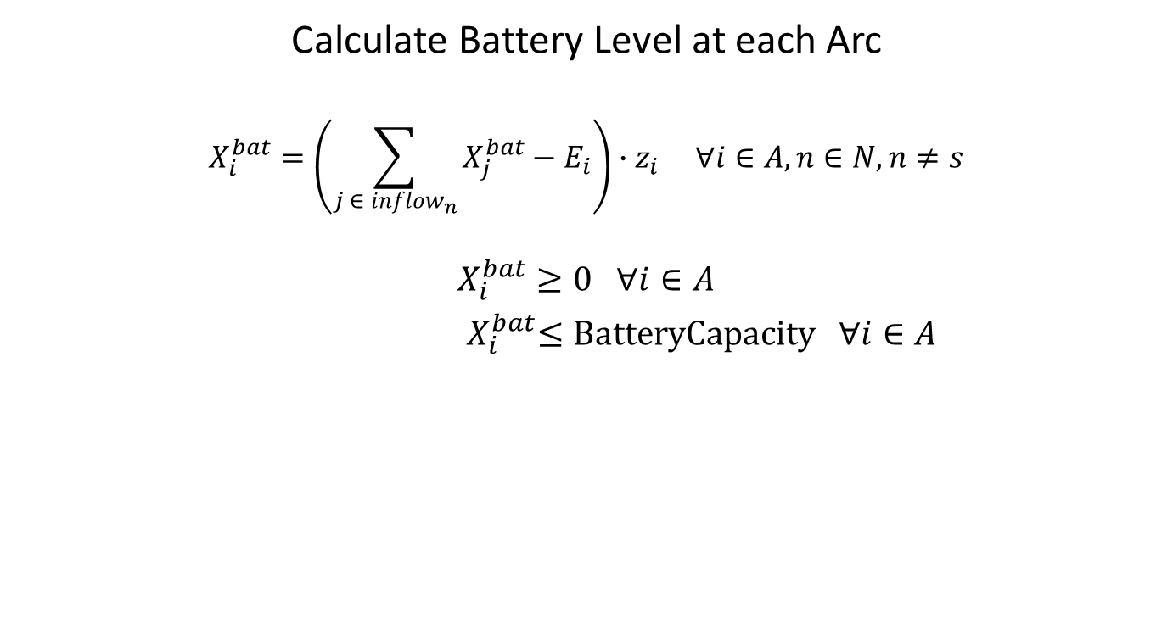
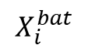
Battery Constraints
Calculate Battery Level at each Arc
$$X_{i}^{bat}=\left(\sum_{j ∈ inflow_{n}}{X_{j}^{bat}−E_{i}}\right)∙z_{i} ∀i∈A, n∈N, n≠s$$
$X_{i}^{bat}≥0 ∀i∈A$
${ X}_{i}^{bat}≤\text{BatteryCapacity} ∀i∈A$
1
N is all nodes in network
n refers to a single node
s refers to the start node
E_i is the energy cost along arc i
2
4
$$X_{i}^{bat}$$
5
3

Slide 10
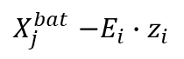
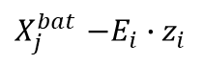
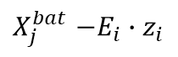
Battery Constraints
Calculate Battery Level at each Arc
$$X_{i}^{bat}=\left(\sum_{j ∈ inflow_{n}}{X_{j}^{bat}−E_{i}}\right)∙z_{i} ∀i∈A, n∈N, n≠s$$
$X_{i}^{bat}≥0 ∀i∈A$
${ X}_{i}^{bat}≤\text{BatteryCapacity} ∀i∈A$
1
N is all nodes in network
n refers to a single node
s refers to the start node
E_i is the energy cost along arc i
$X_{j}^{bat}$ $−E_{i}∙z_{i}$
$X_{j}^{bat}$ $−E_{i}$ $∙z_{i}$
2
4
$$X_{i}^{bat}$$
5
$X_{j}^{bat}$ $−E_{i}∙z_{i}$
3

Slide 11
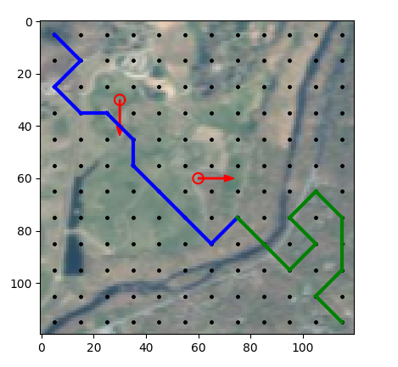
Output
500 m
500 m

Slide 12
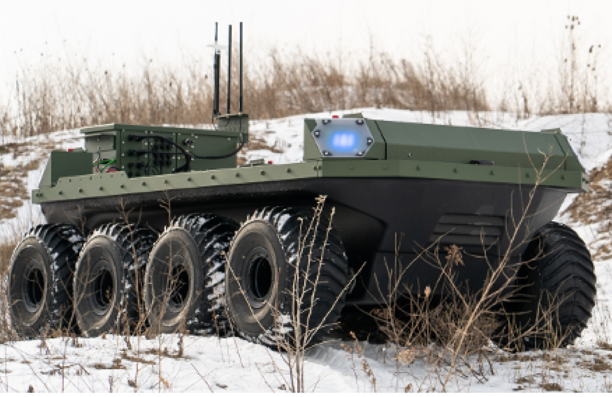
Next Steps
Finish Writing Paper
Ability to charge in place
Apply to real UGV

Slide 13
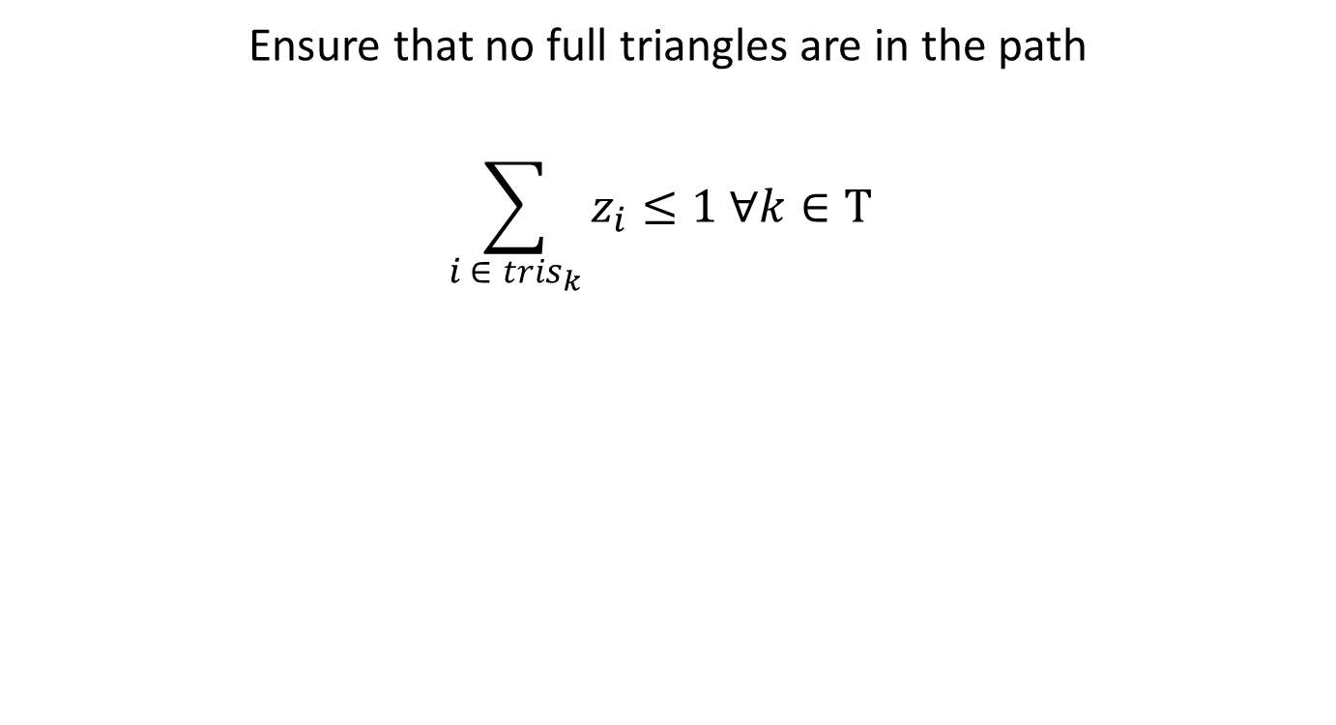
Triangle Constraint
Ensure that no full triangles are in the path
$$\sum_{i ∈ tris_{k}}{z_{i}≤1 ∀k∈\text{T} }$$
S
1
2
S
1
2
3
4
F
3
4
F
Notes:
Looks continuous but is really
Lower area is lower prob of det
Callout for di and x_i
Animate it

Slide 14
Model Inputs
Triangles: all full triangles in terms of arcs
1
2
3
4
5
6
7
8
9
Notes:
ArcID, Start Node, End Node, Risk, Time, Energy Level, Charging Boolean

Slide 15
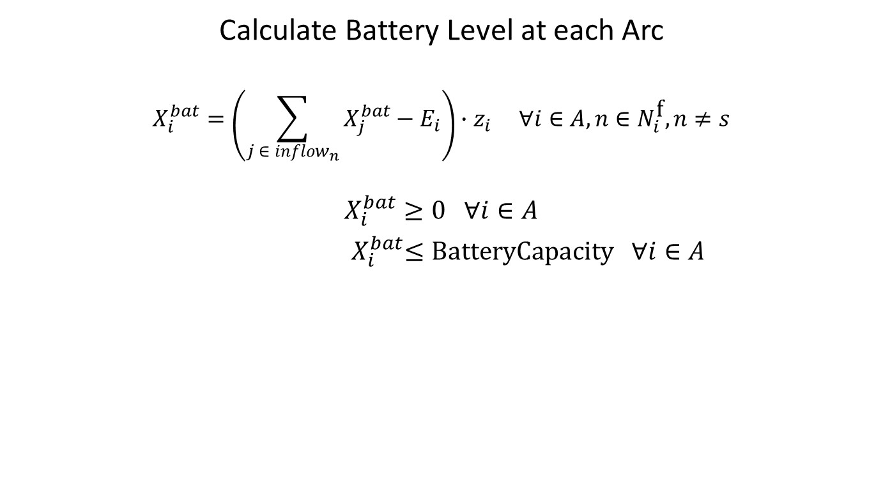
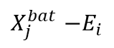
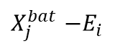
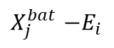
Battery Constraints
Calculate Battery Level at each Arc
$$X_{i}^{bat}=\left(\sum_{j ∈ inflow_{n}}{X_{j}^{bat}−E_{i}}\right)∙z_{i} ∀i∈A, n∈N_{i}^{\text{f}}, n≠s$$
$X_{i}^{bat}≥0 ∀i∈A$
${ X}_{i}^{bat}≤\text{BatteryCapacity} ∀i∈A$
1
$X_{j}^{bat}$ $−E_{i}$
$X_{j}^{bat}$ $−E_{i}$
2
4
$$X_{i}^{bat}$$
5
$X_{j}^{bat}$ $−E_{i}$
3

Slide 16
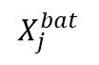
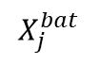
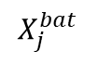
Battery Constraints
Calculate Battery Level at each Arc
$$X_{i}^{bat}=\left(\sum_{j ∈ inflow_{n}}{X_{j}^{bat}−E_{i}}\right)∙z_{i} ∀i∈A, n∈N_{i}^{\text{f}}, n≠s$$
$X_{i}^{bat}≥0 ∀i∈A$
${ X}_{i}^{bat}≤\text{BatteryCapacity} ∀i∈A$
1
$$X_{j}^{bat}$$
$$X_{j}^{bat}$$
2
4
$$X_{i}^{bat}$$
5
$$X_{j}^{bat}$$
3

